Slide 1
Selection on unobservables
Using natural experiments to identify causal effects

Slide 2
Selection on unobservables
Recall the identifying assumptions when estimates causal effect using conditioning strategies
Independence: (Y⁰,Y¹) || D, X
Condition on exogenous covariates that close all open backdoor paths
Do not condition on colliders
Use methods like propensity score matching and condition on p(X), or regression
What if treatment assignment to units based on some unobserved variable, u, which is correlated with the outcome?
Conditioning strategies are invalid
Selection on unobservables methods may work
Angrist and Lavy (1999): “Using Maimonedes’ Rule to Estimate the Effect of Class Size on Scholastic Achievement”, Quarterly Journal of Economics

Slide 3
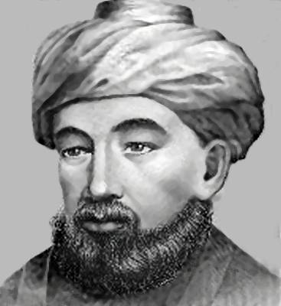
Maimonedes Rule
“Causal effects of class size on pupil achievement have proved very difficult to measure. Even though the level of educational inputs differs substantially both between and within schools, these differences are often associated with factors such as remedial training or students’ socioeconomic background … The great twelfth century Rabbinic scholar, Maimonides, interprets the Talmud’s discussion of class size as follows: “Twenty-five children may be put in charge of one teacher. If the number in the class exceeds twenty-five but is not more than than forty, two teachers must be appointed.’ … The importance of Maimonides’ rule for our purposes is that since 1969, it has been used to determine the division of enrollment cohorts into classes in Israeli public schools.” (Angrist and Lavy 1999).

Slide 4
Natural experiments: Example 1
Angrist and Lavy (1999) are interested in the causal effect of class size (D) on education outcomes (Y)
Data: 86 paired Israeli schools matched on covariate, x (share of disadvantaged children)
They were matched on observable covariate x
but are treatment group students equivalent to control on both x and u, not just x?
Treatment: Small class size is the treatment
Treatment: 41-50 students in 5th grade (D=1)
Control: 31-40 students in 5th grade (D=0)

Slide 5
Exogenous variation in class size
Class size in most places and most times is strongly associated with unobservable determinants of educational performance
Poverty, affluence, enthusiasm or skepticism about the value of education, special needs of students for remedial or advanced instruction, obscure and barely intelligible obsessions of bureaucracies
Each of these determines class size and clouds the actual effect of class size on academic performance because each is also correlated with academic performance itself
However, if adherence to Maimonides’ rule is perfectly rigid, then what separates School A with a single class of size 40 from School B with two classes whose average size is 20.5?
the enrollment of a single student

Slide 6
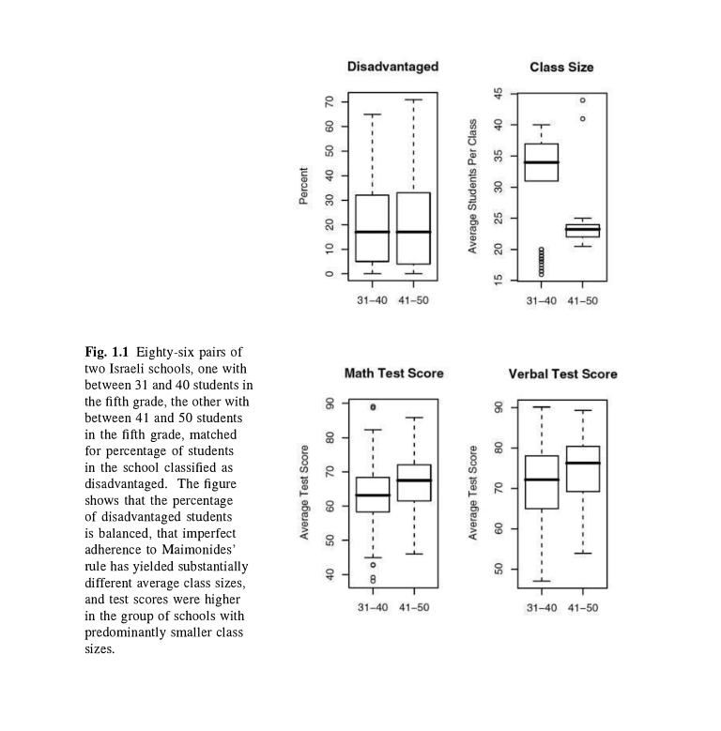
Exogenous variation in class size
Maimonides’ rule has the largest impact on a school with about 40 students in a grade cohort
With cohorts of size 40, 80 and 120 students, the steps down in average class size required by Maimonides’ rule when an additional student enrolls are (respectively) from 40 to 20.5 (41/2), 40 to 27 (81/3) and 40 to 30.25 (121/3)
Schools also use the percent disadvantaged students in a school “to allocate supplementary hours of instruction and other school resources”, so Angrist and Lavy created 86 matched pairs of schools using this covariate, x
Upper left panel: balanced on x; top right shows Maimonides Rule working; bottom left and right: math and verbal test scores were higher where class sizes tended to be smaller

Slide 7
(Un)-Natural experiments
Angrist and Lavy (1999) are interested in the causal effect of class size on academic performance, and while they can match on observables, it is widely known that selection on unobservables is a more apt description of the problem
They solve this problem by exploiting Maimonides’ Rule
Maimonides’ Rule cuts classes in half when they reach a prescribed point
The key is that the decision to create classes of different sizes is based on an arbitrary cutoff which is unrelated to unobservable determinants of D or Y
They call it a “natural experiment” but what does that mean?
An attempt to find in the world some rare circumstance such that a consequential treatment was handed to some people and denied to others haphazard reasons
Caveat: “The word `natural’ has various connotations, but a `natural experiment’ is a `wild experiment’ not a `wholesome experiment’, nature in the way that a tiger is natural, not in the way that oatmeal is natural” (Rosenbaum 2005, Design of Observational Studies)
Haphazard variation in treatment is not like variation in a randomized experiment
Randomization: “We definitely know that the probability of treatment for the large class size and the small class size units was equal by the way treatments were assigned”, versus
Natural experiment: “It does seem reasonably plausible that the probability of treatment for the kids in the small class sizes and the kids in the large class sizes is fairly close”.

Slide 8
Treatment selection and naiveté
Naïve matching
“People who look comparable are comparable”. NO
Matching/subclassification/regression can create matched sample who look similar on x
Matching, etc. cannot created a matched sample who are similar on u (unobservables), though
Definition of naiveté: a person who believes something because it’s convenient to believe it

Slide 9
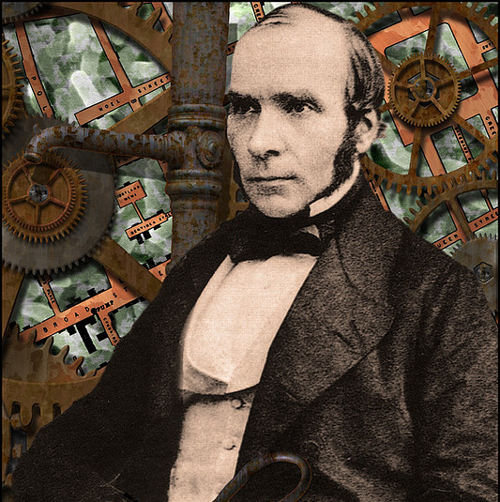
Story of the Broad Street Pump (ex. 2)
Dr. John Snow was:
A practicing physician
An anesthesiologist
Studied “poisons / morbid matters
Father of epidemiology
Provided early evidence that cholera was waterborne disease
He lived from 1813 - 1858

Slide 10
Cholera science in 1800s
Go back in time and forget that germs cause disease
Microscopes were available but their resolution was poor
Most human pathogens can’t be seen
Isolating these microorganisms wouldn’t occur for half a century
The “infection theory” was the minority view; main explanation was “miasmas”
Minute, inanimate poison particles in the air

Slide 11
Background
Cholera arrives in Europe in the early 1800s and exhibits “epidemic waves”
Attacked victims suddenly
Usually fatal
Symptoms were vomiting and acute diarrhea
Snow observed the clinical course of the disease and made the following conjecture:
the active agent was a living organism that entered the body, got into the alimentary canal with food or drink, multiplied in the body, and generated some poison that caused the body to expel water
The organism passed out of the body with these evacuations, entered the water supply, and infected new victims
The process would repeat itself, growing rapidly through the common water supply, causing an epidemic
There were three main epidemics in London
1831-1832
1848-1849 (~15,000 deaths)
1853-1854 (~30,000 deaths)

Slide 12
Background
Snow is an early advocate for the “infection theory” – cholera is being spread person-to-person through an unknown mechanism
His early evidence for this “infection theory” was based on years’ worth of observations which included:
Cholera transmission followed human commerce
A sailor on a ship from a cholera-free country who arrived at a cholera-stricken port would only get the disease after landing or taking on supplies
Cholera hit poor communities the worst, who lived in the most crowded housing with the worst hygiene
These facts are consistent with the infection theory, but were harder to reconcile with the miasma theory

Slide 13
More observational evidence supporting Snow’s infection theory
Snow identifies Patient Zero: the first case of an early epidemic:
“a seaman named John Harnold, who had arrived by the Elbe steamer from Hamburg, where the disease was prevailing
The second case is Harnold’s roommate

Slide 14
And more evidence from later epidemics
Snow studied two apartment buildings
The 1st was heavily hit with cholera, but the 2nd wasn’t
He found the water supply in the 1st building was contaminated by runoff from privies but the water supply in the 2nd was much cleaner
Earlier water supply studies
In the London of the 1800s, there were many different water companies serving different areas of the city
Some were served by more than one company
Several took their water from the Thames, which was heavily polluted by sewage
The service areas of such companies had much higher rates of cholera
The Chelsea water company was an exception, but it had an exceptionally good filtration system

Slide 15
Broad Street Water Pump
1849:
Lambeth water company moved the intake point upstream along the Thames, above the main sewage discharge points
Pure water
Southwark and Vauxhall water company left their intake point downstream from where the sewage discharged
Infected water
Comparisons of data on cholera deaths from the 1853-54 showed that the epidemic hit harder in the Southwark and Vauxhall service areas (infected water supply) and largely spared the Lambeth areas (pure water)

Slide 16
Snow’s Table IX
 | Number of houses | Deaths from cholera | Deaths per 10,000 houses
Southwark and Vauxhall | 40,046 | 1,263 | 315
Lambeth | 26,107 | 98 | 37
Rest of London | 256,423 | 1,422 | 59
Snow concluded that if the Southwark and Vauxhall company had moved their intake point as Lambeth did, about 1,000 lives
would have been saved.
Counterfactual inference, quasi-randomized treatment assign- ment to control for confounding variables

Slide 17
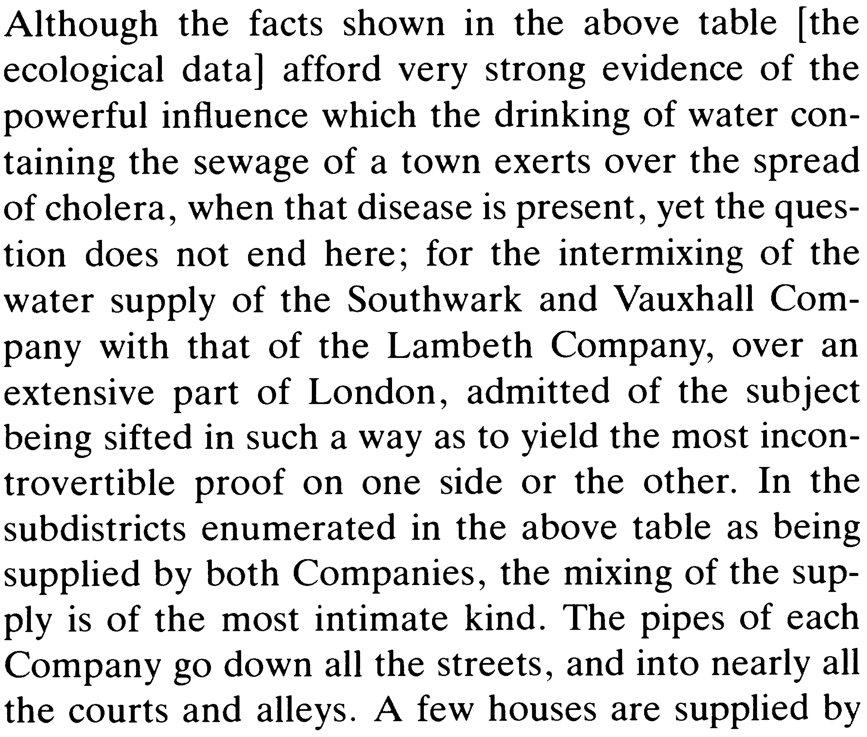
So what about u?

Slide 18
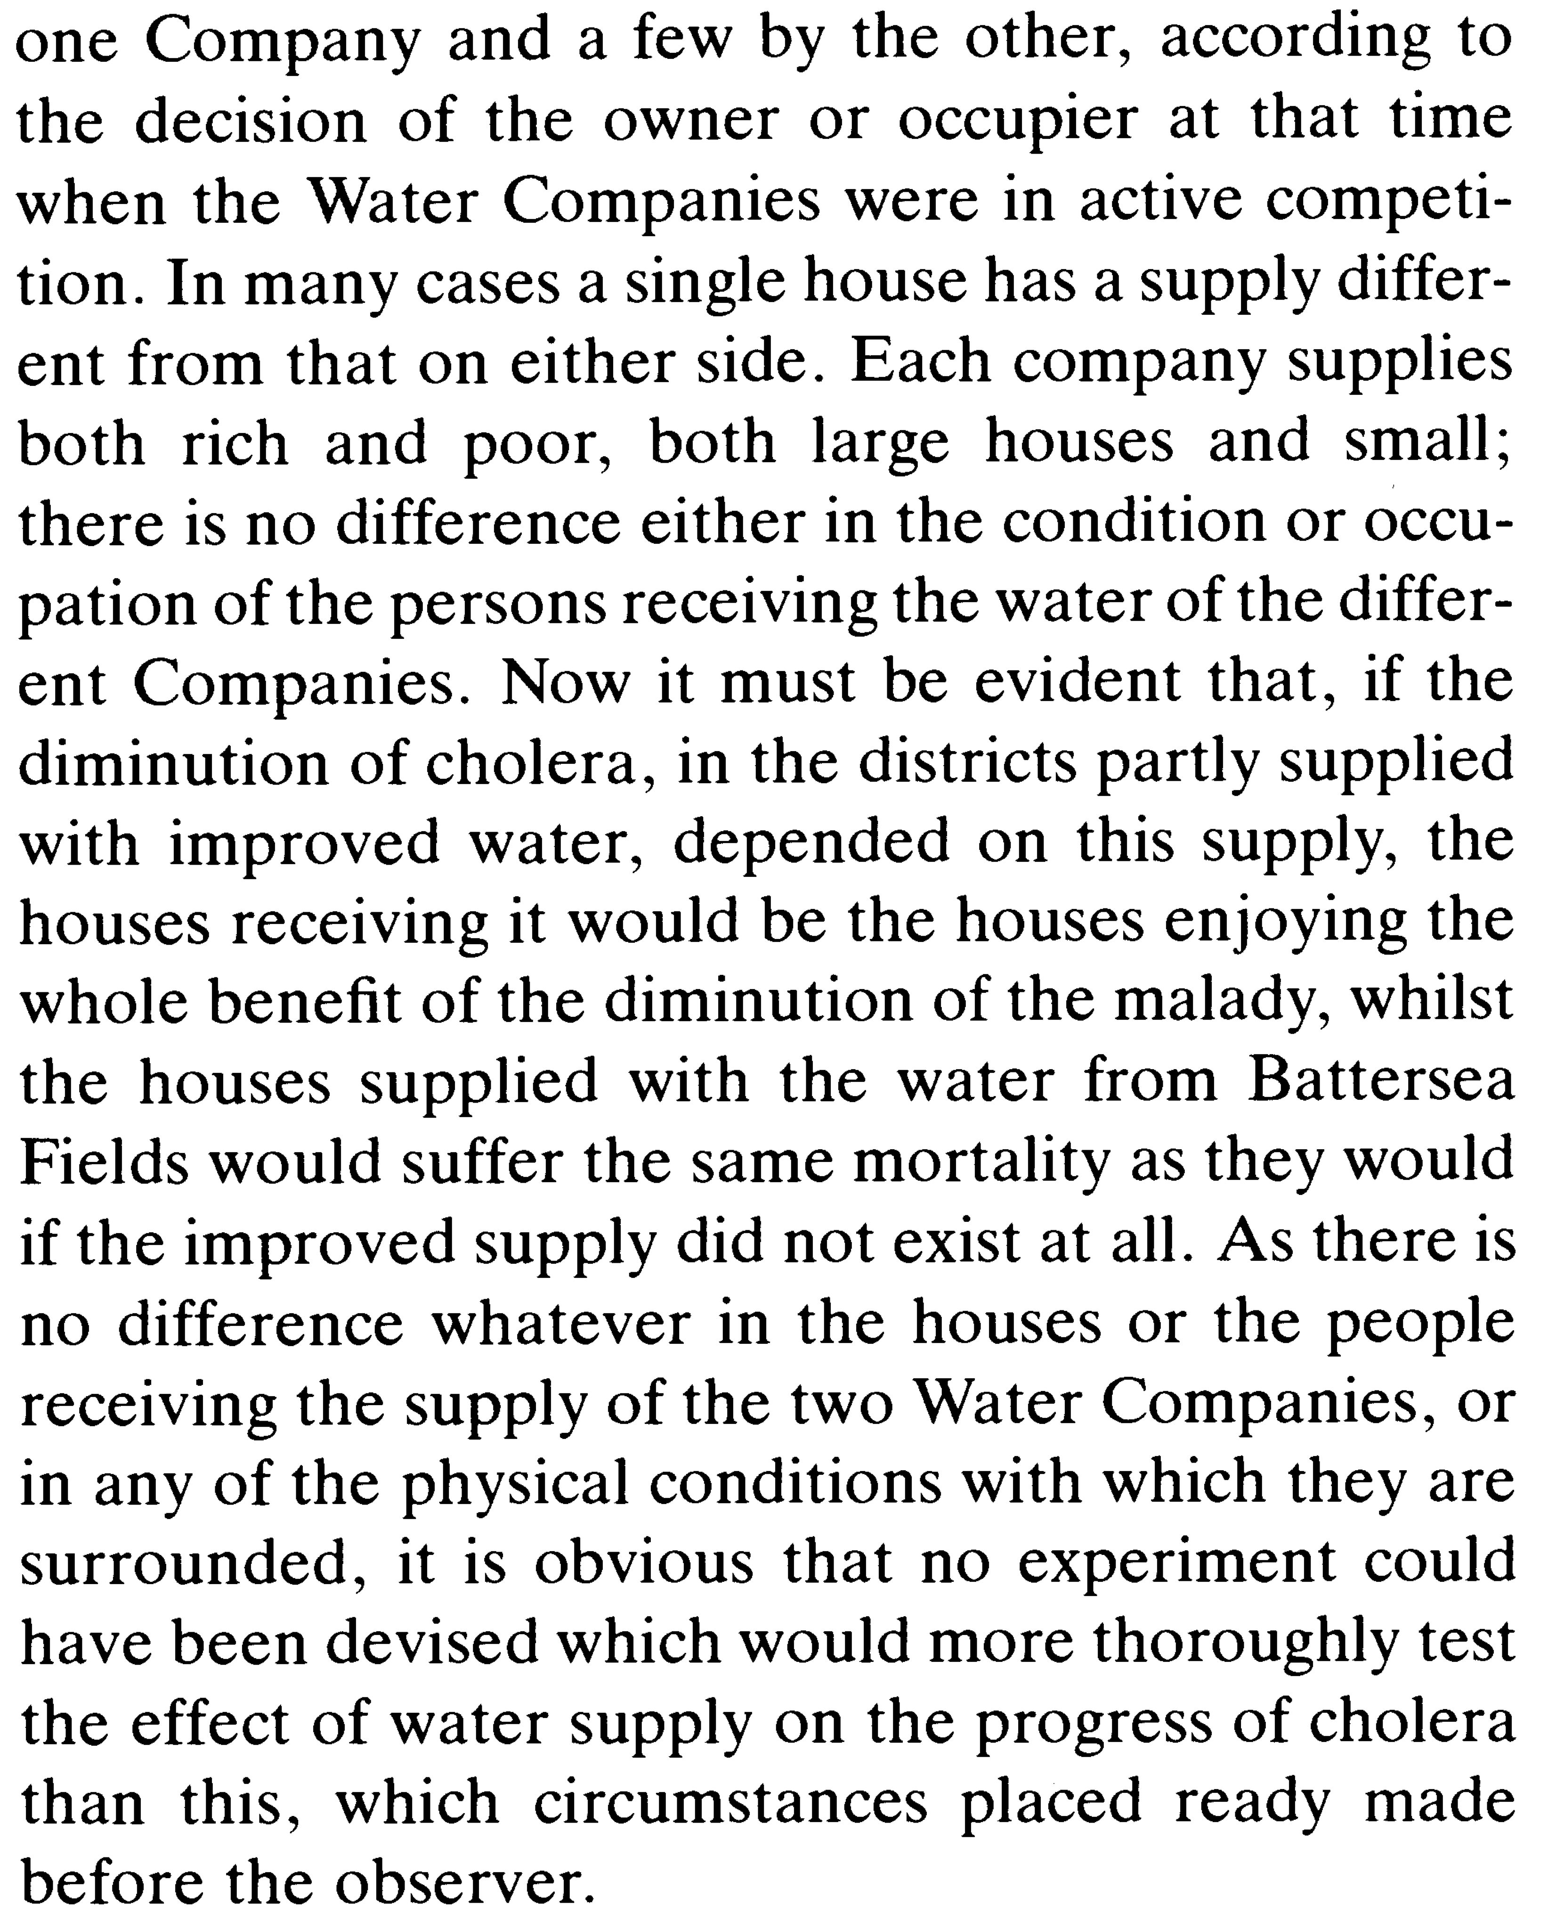

Slide 19
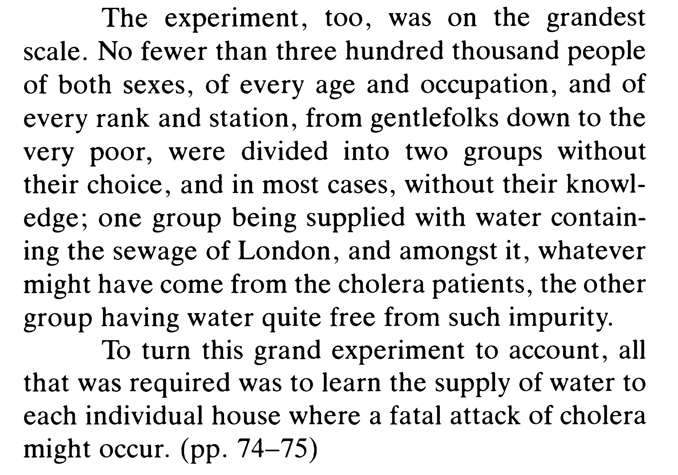

Slide 20
Snow’s Table IX
 | Number of houses | Deaths from cholera | Deaths per 10,000 houses
Southwark and Vauxhall | 40,046 | 1,263 | 315
Lambeth | 26,107 | 98 | 37
Rest of London | 256,423 | 1,422 | 59
David Freedman (1991)’s “Statistical Models and Shoe Leather”:
“As a piece of statistical technology, [Snow’s Table IX] is by no means remarkable. But the story it tells is very persuasive. The force of the argument results from the clarity of the prior reasoning, the bringing together of many different lines of evidence, and the amount of shoe leather Snow was willing to use to get the data.”
“Snow did some brilliant detective work on nonexperimental data. What is impressive is not the statistical technique but the handling of the scientific issues. He made steady progress from shrewd observation through case studies to analyze ecological data. In the end, he found and analyzed a natural experiment.
“He also made his share of mistakes: For example, based on rather flimsy analogies, he concluded that plague and yellow fever were also propagated through the water.”

Slide 21
Example 3 (bad example)
Kanarek, et. al. (1980), American Journal of Epidemiology (leading journal in the field)
Big finding: asbestos fibers in drinking water caused lung cancer
722 census tracts in San Francisco Bay Area
Large variations in fiber concentrations from one tract to another (by factors of 10 or more)
Examined cancer rates at 35 sites for blacks and whites, men and women
Controlled for age, sex and race, and used loglinear regression to control for other covariates
Causation was inferred based on whether a coefficient in the model was statistically significant after controlling for covariates

Slide 22
Asbestos and lung cancer
Kanarek et al (1980) do not discuss their stochastic assumptions
Their model assumes independence of treatment assignment conditional covariates
Regression language: they assume conditional independence – that the error term is i.i.d. given covariates and treatment is conditionally exogenous – without justification
“Theoretical construction of the probability of developing cancer by a certain time yields a function of the log form” (1980, p. 62)
But this model of cancer causation is open to serious objections (Freedman and Navidi 1989)
Findings
First, they confuse “statistical significance” for “economic significance”:
For lung cancer in white males, the asbestos fiber coefficient was highly significant (p<0.001), so the “effect” was described as “strong”
But in reality, their model actually only predicts a risk multiplier of 1.05 for 100-fold increase in fiber concentrations
They found no effect in women or blacks
They had no data on cigarette smoking, which affects cancer rates by a factor of 10 or more
Therefore, imperfect control over smoking could easily account for the observed “effect”, as could even minor errors in functional form
Ran 200+ equations. Only one of the P values was below 0.001.
So the real significance is closer to 0.20 (200 x 0.001 = 0.20).
Their model based argument, in a nutshell, sucks

Slide 23
Summary
In many papers, adjustment for covariates is done by regression and the argument for causality rides on the statistical significance of a coefficient
Statistical significance levels depend on specifications, particularly of the error structure
For example, whether the errors are or are not correlated, whether they are heteroskedastic
Often the stochastic specification is never argued in any detail
Modeling the covariates does not fix the problem of selection on unobservables unless the model for the covariances can be validated

Slide 24
Summary of when research usually fails
There is an interesting research question which may or may not be sharp enough to be empirically testable
Relevant data are collected, although there may be considerable difficulty in quantifying some of the concepts, and important data may be missing
The research hypothesis is quickly translated into a regression equation, more specifically, into an assertion that certain coefficients are (or are not) statistically significant
Some attention is then paid to getting the right variables into the equation, although the choice of the covariates is usually not compelling
Little attention is paid to functional form assumptions, stochastic specification; textbook linear models are just taken for granted

Slide 25
Theory, Causality, Statistics
“The aim is to provide a clear and rigorous basis for determining when a causal ordering can be said to hold between two variables or groups of variables in a model. The concepts all refer to a model – a system of equations – and not to the real world the model purports to describe.” (Simon 1957, p. 12)
“If we choose a group of social phenomena with no antecedent knowledge of the causation or absence of causation among them, then the calculation of correlation coefficients, total or partial, will not advance us a step toward evaluating the importance of the causes at work.” (Fisher 1958, p. 190).
Notes:
In Freedman’s view, regression is not a particularly good way of doing empirical work in the social sciences today. It’s simply too easy to let the statistical modeling substitute for real thinking, and it allows you to feign knowledge when you are in fact ignorant. There is no getting around the fact that all statistical analysis for causal inference purposes depends on theoretical assumptions and knowledge of the thing you are studying.

Slide 26
Testing the germ theory
We are interested in the causal effect of water purity on cholera
ATE = E[Y¹ – Y⁰]
Test it using data on water quality and cholera outbreaks
E[Cholera | Pure water] – E[Cholera | Dirty water]
Selection bias. Deaton (1997) “The people who drank impure water were also more likely to be poor, and to live in an environment contaminated in many ways, not least by the `poison miasmas’ that were then thought to be the cause of cholera.”
Selection on unobservables make naïve comparisons noninformative
We need variation in purity of water that is independent of the unobserved determinants of cholera without treatment
(Y⁰) || D – If treatment assignment is independent of cholera under control, then we can estimate E[Y¹|D=1] – E[Y⁰|D=0], or ATT

Slide 27
Snow’s treatment assignment
Snow identifies variation in water purity that is independent of cholera mortality: the relocation of water inlet upstream
At this time, Londoners’ water was supplied by two companies: Southwark & Vaushall Company and Lambeth Company
In 1849 (prior to 1854 cholera outbreak), cholera mortality rates were similar between the two areas serviced by LC and SV
In 1852, Lambeth moved its inlet to a cleaner water supply upstream on the Thames
Water purity upstream was uninfected

Slide 28
Snow’s treatment assignment
A valid instrument has several characteristics
The instrument must be strongly correlated with the treatment variable
Instrument must be correlated with clean water
At the time, Londoners received drinking water directly from the Thames River
Lambeth water company drew water at a point in the Thames above the main sewage discharge, while Southwark and Vauxhall company took water below the discharge
The instrument cannot be correlated with the unobserved variables along the backdoor path from the treatment to the outcome
We cannot test this, as the variables on the backdoor path are unobserved

Slide 29
Snow’s treatment assignment
Cannot prove the second point because of missing data (hence the problem to begin with)
Snow compared the households served by two companies from previous years
“the mixing of the supply is of the most intimate kind. The pipes of each Company go down all the streets, and into nearly all the courst and alleys…. The experiment, too, is on the grandest scale. No fewer than three hundred thousand people of both sexes, of every age and occupation, and of every rank and station, from gentlefolks down to the very poor, were divided into two groups without their choice [no self-selection], and in most cases, without their knowledge; one group supplied with water containing the sewage of London, and amongst it, whatever might have come from the cholera patients, the other group having water quite free from such impurity.”

Slide 30
Natural experiments
Differences in differences estimation

Slide 31
Popularity of “causal” methodologies

Slide 32
Selection on unobservables
Problem
Often there are reasons to believe that treated and untreated units differ in their observable characteristics and their unobservable characteristics, each of which is associated with potential outcomes
Thus, even after controlling for differences in observed characteristics, units will continue to differ from one another along unobserved characteristics that are themselves independently associated with potential outcomes
In such cases, treatment and control units may not be directly comparable, even after we adjust for observables
Question
If there is selection on unobservables, can we still identify and estimate causal effects?
Selection on unobservable DAG There does not exist a set of variables that we could condition on that satisfies the backdoor criterion in the above DAG
D <- - - u - - -> Y is always open

Slide 33
Example: Minimum wage laws and employment
Do higher minimum wages decrease low-wage employment?
Card and Krueger (1994) consider impact of New Jersey’s 1992 minimum wage increase from $4.25 to $5.05 per hour
Compare employment in 410 fast-food restaurants in New Jersey and eastern Pennsylvania before and after the rise
Survey data on wages and employment from two waves:
Wave 1: March 1992, one month before the minimum wage increase
Wave 2: December 1992, eight months after increase in the minimum wage

Slide 34
Location of Restaurants (Card and Krueger 2000)

Slide 35
Wages before min wage increase

Slide 36
Wages after min wage rise

Slide 37
Two groups and two periods
Definition:
Two groups:
D=1 Treatment unit
D=0 Control unit
Two periods:
T=0 Pre-treatment period
T=1 Post-treatment period
Potential outcomes Y^{D}(t)
Y¹_{i}(t) potential outcome unit i attains in period t when treated between t and t-1
Y⁰_{i}(t) potential outcome unit i attains in period t when treated between t and t-1

Slide 38
Two groups and two periods
Definition:
Causal effect for unit i at time t is
= Y¹_{i}(t) – Y⁰_{i}(t)
Observed outcomes Y_{i}(t) are realized as:
Y_{i}(t) = Y¹_{i}(t)D_{i}(t) + Y⁰_{i}(t)[1-D_{i}(t)]
Fundamental problem of causal inference
If D occurs only after t=0, then D_{i}=D_{i}(1) and Y_{i}(0)=Y⁰_{i}(0)
We then have: Y_{i}(1)=Y⁰_{i}(1)[1-D_{i}]+Y¹_{i}(1)D_{i}
Estimand (ATT)
Focus on estimating the average treatment effect on the treatment group:

Slide 39
Two groups and two periods
Estimand (ATT):
 | Post-period (T=1) | Pre-Period (T=0)
Treated (D=1) | E[Y¹(1)|D=1] | E[Y⁰(0)|D=1]
Control (D=0) | E[Y⁰(1)|D=0] | E[Y⁰(0)|D=0]
Data we have:
Top left: Average post-period outcome for treatment units when they receive treatment
Bottom left: Average post-period outcome for control units when they didn’t receive treatment
Top right: Average pre-period outcome for treatment units when they didn’t receive treatment
Bottom right: Average pre-period outcome for control units when they didn’t receive treatment
Data we need for ATT:
E[Y¹(1)|D=1] and E[Y⁰(1)|D=1]
Fundamental Problem:
Missing: Average post-period outcome for treatment units in the absence of the treatment (E[Y⁰(1)|D=1]).

Slide 40
Two groups and two periods
Estimand (ATT):
 | Post-period (T=1) | Pre-Period (T=0)
Treated (D=1) | E[Y¹(1)|D=1] | E[Y⁰(0)|D=1]
Control (D=0) | E[Y⁰(1)|D=0] | E[Y⁰(0)|D=0]
Control strategy idea #1: Before vs. After
Use:

Slide 41
Two groups and two periods
Estimand (ATT):
 | Post-period (T=1) | Pre-Period (T=0)
Treated (D=1) | E[Y¹(1)|D=1] | E[Y⁰(0)|D=1]
Control (D=0) | E[Y⁰(1)|D=0] | E[Y⁰(0)|D=0]
Control strategy idea #1: Before vs. After
Use:
Assumes:

Slide 42
Two groups and two periods
Estimand (ATT):
 | Post-period (T=1) | Pre-Period (T=0)
Treated (D=1) | E[Y¹(1)|D=1] | E[Y⁰(0)|D=1]
Control (D=0) | E[Y⁰(1)|D=0] | E[Y⁰(0)|D=0]
Control strategy idea #2: Treated vs. Control in Post-Period
Use:

Slide 43
Two groups and two periods
Estimand (ATT):
 | Post-period (T=1) | Pre-Period (T=0)
Treated (D=1) | E[Y¹(1)|D=1] | E[Y⁰(0)|D=1]
Control (D=0) | E[Y⁰(1)|D=0] | E[Y⁰(0)|D=0]
Control strategy idea #2: Treated vs. Control in Post-Period
Use:
Assumes:

Slide 44
Two groups and two periods
Estimand (ATT):
 | Post-period (T=1) | Pre-Period (T=0)
Treated (D=1) | E[Y¹(1)|D=1] | E[Y⁰(0)|D=1]
Control (D=0) | E[Y⁰(1)|D=0] | E[Y⁰(0)|D=0]
Control strategy: Differences-in-Differences (DD)
Use:

Slide 45
Two groups and two periods
Estimand (ATT):
 | Post-period (T=1) | Pre-Period (T=0)
Treated (D=1) | E[Y¹(1)|D=1] | E[Y⁰(0)|D=1]
Control (D=0) | E[Y⁰(1)|D=0] | E[Y⁰(0)|D=0]
Control strategy: Differences-in-Differences (DD)
Use:
Assumes:

Slide 46
Graphical representation: DD

Slide 47
Identification with Difference-in-Difference
Identification Assumption (parallel trends)
Given parallel trends, the ATT is identified as:

Slide 48
Identification with Difference-in-Difference
Identification Assumption (parallel trends)
Proof:

Slide 49
Identification with Difference-in-Difference
Identification Assumption (parallel trends)
Estimators:
If we can assume parallel trends, how mechanically will we actually estimate ATT using DD? I’ll review some applications now, including STATA code.

Slide 50
Differences-in-differences estimator
Definition: Average treatment effect on the treatment (ATT)
Estimator: Sample means using panel data

Slide 51
Sample means: min wage laws and employment

Slide 52
DD Estimators
Estimator: (Sample means using repeated Cross-sections)
Let {Y_{i},D_{i},T_{i}} for i=1 to n be the pooled sample (the two different cross-sections merged) where T is a random variable indicating the period (0 or 1) in which the individual is observed
The DD estimator is then given by the following:

Slide 53
DD Estimators: simple regression
Estimator: Regression using repeated cross-sections
Alternatively, the same estimator can be obtained using regression techniques. Consider the following linear model:
Notes:
The (simple) regression is the most common way you’ll see DD models estimated. Let D be the binary indicator for treatment, and T be a binary indicator for the post-treatment period. The interaction, D x T, is the product of D and T, so is equal to 1 only when D and T equal 1. It is equal to zero for the comparison group units, the pre-treatment period or both. Note that the coefficients – mu, gamma, tau and delta – all assume that you have held everything else constant

Slide 54
Notes:
First, let’s go back to the graphical diff-in-diff that we presented earlier. Notice what I’ve marked (the vertical bar will help maybe distinguish the two time periods. When D=0 and T=0, then Y is determined by mu plus the error term. These points are average outcomes, so the average is mu if E[e|D,T]=0 (see previous slide). If D=1, then E[Y]=mu+tau. Note that since D=1 but T=0, this is just the baseline difference in average outcomes for the treatment and control group in the pre-treatment period (hence it’s appearance on the top left). If T=1 but D=0, then it’s mu + tau (substituting T=1 and D=0 into the equation). Finally, for T=1 and D=1, it’s all four coefficients, which is the top right.

Slide 55
Notes:
Note that the regression model is mu+gD+tT+d(DxT)+e where D, T and DxT all have their respective coefficients, g, t and d. OLS estimates of delta is equivalent to the following steps: 1. difference between treatment (mu + gamma) and control (mu) in the pre-treatment period (D0); 2. difference between treatment (mu+gamma+tau+delta) and control (mu+tau) in the post-treatment period (D1); 3. difference between the post-treatment difference (D1) and the pre-treatment difference (D0). The “differences in the differences” estimator is at the bottom right, and it is consistently estimating the actual parameter of interest if the parallel trends assumption holds.

Slide 56
DD Estimators
Estimator: Regression: Repeated Cross-sections
We can also see this working out in the following table using the same regression model
 | After (T=1) | Before (T=0) | After – Before
Treatment (D=1)
Control (D=0)
Treatment - Control
Notes:
Here we look at the same statistical model estimated with OLS but now we are going to examine the differences in differences with a table. OLS estimates the differences in the differences and you get the same answer whether you do these differences horizontally (row by row) and then differencing down (tau+delta)-(tau)=delta, or if you were to do the initial differences vertically for each After (gamma+delta) and Before column (gamma) and then differenceing those two cells to get delta. OLS essentially isolates the treatment effect because the elements of the determinants of Y are linear. Thus, differences works.

Slide 57
Regression: Minimum wage laws and employment
Notes:
How do we actually implement this regression model in STATA? I’ve distributed the dataset for the Card and Krueger minimum wage data to you already. It’s entitled CK1994_longformat.dta. Type in “use CK1994_longformat.dta, clear” from the command prompt. Then describe the variables IS nj postperiod emptot. The first variable is the restaurant index which identifies a particular restaurant. Notice that there are two copies of each ID identifier. Next is the NJ variable. This is a dummy variable equalling 1 if NJ, 0 if PA. Next, look at the variable “postperiod”. This is a dummy equalling 1 if it’s after the minimum wage increase and 0 if before. Notice that for each ID value, there is a record corresponding to the pre-period (postperiod=0) and a record corresponding to the post-period (postperiod=1). Finally, we have full time equivalent employment levels.

Slide 58
Regression: Minimum wage laws and employment
Notes:
Now I want to estimate the model we’ve discussed so far. For this model, you need three explanatory variables: a post-period indicator (which we have already), a cross-sectional indicator to distinguish the treatment from the control (which we have), and a variable that is the product of them both, which we do not have. Therefore we will need to generate that variable now. Notice how I generate it: by using the –generate- command. And notice that I’m using –gen- to simply create the product of the two variables, nj and postperiod. Since both are dummy variables, the product of the two will be equal to 1 only when both nj and postperiod are 1. Now, we’re ready. We want to estimate the simple statistical model equivalent of the equation on the previous slides by typing “regress OUTCOME VARIABLES”, or here “reg emptot postperiod nj nj_X_post”. That is independently enough to estimate the coefficients of interest, but this model will assume that the error term is spherical (homoskedasticity assumption). We can automatically correct for this flawed assumption by correcting the standard errors for heteroskedasticity using the “, robust” command. This will adjust the standard errors by implementing the Huber-White sandwich estimator that corrects for when the variance in the disturbances is non-spherical. But, as we will learn when you return from spring break, heteroskedasticity is not the only worry we often have when it comes to the unobserved factors that determine the outcome. Another is serial correlation in the disturbances, which is to say that errors are correlated for units, I, over time, T. Bertrand, Duflo and Mullainthan have a paper in the 2004 QJE entitled “Should we Trust DD?” in which they show that the heteroskedasticity correction of the Huber-White yields Ses that are too small. They review a number of adjustments, one of which is to cluster the standard errors within a given grouping level, and recommend using the level of the treatment itself as the cluster. This means that within that level (the cluster), error values are iid. But not across clusters. As we only have a single treatment and control, we’d only have two units, so here I am going to cluster at the firm level (ID), but note we will return to this soon. The interpretation here is of importance for the time being: we see in the STATA output the following. The first column lists variables names, the second coefficient estimates, and the third the standard error. The remainder is the t-statistic, the p-value for the coefficient, and 95% confidence intervals. The outcome is “emptot” (hence why it appears in the column header). The first row is the coefficient and test statistics corresponding to the postperiod covariate. As emptot is in levels, we find that the postperiod variable is 2.17 units lower in FTE employment (hours). But, this is over the treatment and the control (T=1 yields mu + tau recall). Next we see nj, the dummy for the treatment unit, and we find that New Jersey has on average 2.89 lower FTE employment than Eastern PA in this sample. Recall, D=1 would yield just mu+gamma if pre-period. Finally, we have the product of NJ and POSTPERIOD: 2.75. Here we find that NJ employment (FTE) rose 2.75 hours over the estimated counterfactual, where our counterfactual was estimated using PA’s before and after data. Notice, the assumptions are operating in our minds but not in the statistical tables – this is only causal if E[Y^0(1)-E[Y^0(0)|D=1] = E[Y^0(1)-E[Y^0(0)|D=0] – that is, what happened in PA would’ve happened in NJ. It’s a quite strong assumption, so for our purposes, we want to defned the result. We will only note how this result was generated.

Slide 59
Useful STATA Syntax
Notes:
Another way to estimate the same thing in STATA 12 is to use the ## operators. These will generate the dummy variable product between nj and postperiod by simplying regressing emptot onto nj##postperiod. Notice that since you did it in the context of running the regression, it created three temporary variables: 1.postperiod, 1.nj, and a dummy for the interaction when each is 1. Notice that the result is the same.

Slide 60
DD Estimators
Estimator (Regression: Repeated Cross-sections)
Can use regression version of the DD estimator to include covariates as controls
Introducing any covariate, X, that doesn’t vary over time is not helpful as they all get “differenced” out
Be careful with time-varying X’s: they are often affected by the treatment and may introduce endogeneity (e.g., conditioning on colliders)
Can interact time-invariant covariates with the time indicator, where X is used to explain differences in trends
Notes:
We can also include controls (X). Note that this is similar to what Angrist and Lavy (1999) do when they created matched pairs of Israeli schools using the share of students disadvantaged as the covariate used for matching. This is essentially saying that there exists some set of variables, X, that are correlated with D and Y. You must therefore control for them assuming that the X’s change over time. Note that DD always deletes any variables from analysis that do not change over time as OLS when used on repeated cross-sections will be implementing a DD that differences units over time (after – before). So race for instance – as race is the same value post relative to pre, it will be dropped. It’s common to control for XT (variables interacted with linear trends, for instance) to again try to control for unobserved time changes which are linear in the XT interaction. Just be sure you do not control for X’s that are post-treatment outcomes.

Slide 61
DD Estimators
Estimator: Regression with panel data
With panel data, we can use regression with the dependent variable in first differences:
Notes:
Here I will only briefly review the panel models, as this is a substantive area and I want to keep our focus on the DD model. Earlier, we had repeated cross-sections. But say that you had observations on the same unit (e.g., a student) at multiple points in time. Say we are interested in the causal effect of marriage on earnings (“Marriage Premium”). How do we estimate this in panel data? The first difference model generates a new variable that is each variable minus itself (after minus before). For those variables that do not change over time, such differing will simply eliminate the variable from analysis (Race2 – Race1=0 if Race doesn’t change between periods). We will then estimate the delta parameter on D which is equal to the delta parameter if E[u|Data]=0. This requires that u1 and u2 be uncorrelated with D1 and D2. That is, four conditional mean assumptions: E[u1|D1]=0, E[u1|D2]=0, E[u2|D1]=0, and E[u2|D2=0]. This is required because the error term in this instance a linear function of u1 and u2 (as it is the difference in the error term).

Slide 62
Regression: Min wage laws and employment
Notes:
The STATA syntax for estimating a panel requires first that we “time series set the data” according to the name of the panel unit identifier and the time variable. Here that is done using the command –tsset-. Since firms are observed twice (before and after) ,the panel unit is ID and the time variable is postperiod (equalling 1 for post-period and 0 for pre-period). See here how we generate the first difference: we use the D1. (D1 “dot”). The D1 creates a new variable that is a one-period difference within the ID unit. Notice, because we first “tsset the data” by unit (ID) and time dimension (POSTPERIOD), this command using D1.emptot made it easier to construct a differencing command “vertically”, even though “generate” only works horiontally. This is a nice trick. You can do the math yourself to see, also, that the emptot_delta variable equals emptot in period 1 minus emptot in period 0 for each ID unit (24-40.5=-16.5; 11.5-13.75 = -2.25).

Slide 63
Regression: Min wage laws and employment
Notes:
Now we regress the DELTA variable onto the DUMMY variable. I’ve used robust for this analysis so you can see the alternative command in action. Again, we see that the NJ coefficient is 2.75, though it’s standard errors are slightly larger. (As we used clustering before and robust now, these aren’t directly comparable).

Slide 64
DD: Threats to Validity
Non-parallel dynamics
Compositional differences
Long-term effects vs. reliability
Functional form dependence
Bias is a matter of degree. Small violations of the identification assumptions may not matter much as the bias may be rather small. However, biases may be so large that the estimates we get may be completely wrong, even of the opposite sign of the true treatment effect.
Helpful to avoid overly strong causal claims for DD estimates.
Notes:
Next I’d like to go over some practical issues for you to better understand some of the factors that can threaten the validity of your DD research design.

Slide 65
DD: Threats to validity
Non-parallel dynamics: Often treatments/programs are targeted based on pre-existing differences in outcomes.
“Ashenfelter dip”: participants in training programs often experience a “dip” in earnings just prior to entering the program (that may be why they participate). Since wages have a natural tendency to mean reversion, comparing wages of participants and non-participants using DD leads to an upward biased estimate of the program effect
Regional targeting: NGOs may target villages that appear most promising (or worse off), a form of selection bias

Slide 66
Checks for DD design
It is very common for readers and others to ask a variety of “robustness checks” from a DD design.
Think of these as just commonly employed checks on the believability of the DD findings themselves
Falsification test using data for prior periods
Falsification test using data for alternative control group
Falsification test using alternative “placebo” outcome that should not be affected by the treatment

Slide 67
Falsification test: Data for prior periods

Slide 68
Falsification test: data for prior periods

Slide 69
Falsification test: data for prior periods

Slide 70
Falsification test: data for prior periods

Slide 71
Longer trends in employment (Card and Krueger 2000)

Slide 72
Falsification test: alternative controls
If placebo DD between original and alternative control isn’t zero, original DD may be biased

Slide 73
Triple DDD: Mandated Maternity Benefits (Gruber 1994)

Slide 76
DDD Regression model
Notes:
X are time-varying covariates (t), unit varying covariates (i), and group covariates (j). There’s a before and after dummy (tau), a group dummy (delta), a treatment unit dummy (TREAT), and then interactions of all of them.

Slide 77
How useful is the triple DDD?
The DDD estimate is the difference between the DD of interest and the placebo DD (that is supposed to be zero)
If the placebo DD is non zero, it might be difficult to convince the reviewers that the DDD removes all the bias
If the placebo DD is zero, then DD and DDD give the same results but DD is preferable because standard errors are smaller for DD than DDD

Slide 78
DD: Further Threats to Validity
Functional form dependence: Magnitude or even sign of the DD effect may be sensitive to the functional form, when average outcomes for controls and treated are different at baseline
Training program for the young
Employment for the young increases from 20% to 30%
Employment for the old increases from 5% to 10%
Positive DD effect: (30-20) – (10-5) = 5% increase
But if you consider log changes in unemployment, the DD is [log(30) – log(20)] – [log(10)-log(5)]=log(1.5)-log(2)<0
DD estimates may be more reliable if treated and controls are more similar at baseline

Slide 79
Falsification test: placebo outcomes
Falsification test using placebo outcome that is not supposed to be affected by the treatment
If DD from placebo outcome is non-zero, then DD estimate for original outcome may be biased
Cheng and Hoekstra (2013, JHR) examine the effect of castle doctrine gun laws on homicides
They investigate the effect of the laws on non-gun related offenses, like grant theft auto, and find no evidence of an effect (“second order outcomes”)
Several studies support Becker and Murphy’s (1988) theory of rational addiction for tobacco and alcohol consumption
Auld and Grootendorst (2004, JHE) replicate the exact same models with data for milk, eggs, oranges and apples and find these plausibly non-addictive goods are addictive (casting doubt on the research design of the other studies)
Several studies have found significant networks effects on outcomes such as obesity, smoking, alcohol use, and happiness
Cohen-Cole and Fletcher (2008, BMJ) use similar models and data and find similar network “effects” for things that aren’t contagious like acne, height and headaches

Slide 80
Falsification test: further threats to validity
Compositional differences
One of the risks of a repeated cross-section is that the composition of the sample may have changed between periods
Example:
Hong (2011) uses repeated cross-sectional data from Consumer Expenditure Survey (CEX) containing musical expenditures and internet use for random samples of US households
Study exploits the emergence of Napster (the first sharing software widely used by Internet users) in June 1999 as a natural experiment
Study compares internet users and internet non-users, before and after emergence of Napster

Slide 81
Compositional differences?

Slide 82
Compositional differences?
Diffusion of the internet changes samples (e.g., younger music fans are early adopters)

Slide 83
DD: Further Threats to Validity
Long-term effects vs. reliability:
Parallel trends assumption for DD is more likely to hold over a shorter time-window
In the long-run, many other things may happen that could confound the effect of the treatment
Should be cautious to extrapolate short-term effects to long-term effects

Slide 84
Causal question of the day
“US abandons Effort to Place Graphic Labeling on Cigarettes” (Associated Press, March 20 2013)
US government won’t pursue a legal battle to mandate large, gruesome images on cigarette labeling in an effort to dissuade potential smokers and get current smokers to quit.
What is the causal effect of this type of “demand-side” intervention?
What data would we need to test any hypothesis relating the use of advertising on smoking?
How would we measure smoking?
What is the treatment variable?
What is the counterfactual?
What specific treatment parameter would you be trying to estimate?
How would you go about this using diff-in-diff?

Slide 85
Cheng and Hoekstra (2013), forthcoming Journal of Human Resources
English common law principle required “duty to retreat” before using lethal force against an assailant except when the assailant is an intruder in the home
The home is one’s “castle” – hence, “castle doctrine”
When intruders threated the victim in the home, the duty to retreat was waived and lethal force in self-defense was allowed
Very old principle predating the United States (originating in England)

Slide 86
“Castle doctrine law”
In 2005, Florida passed a law that expanded self-defense protections beyond the house
2000 to 2010, 21 states explicitly put “castle doctrine” into statute, and (more importantly) extended it to places outside the home
In other words, 21 states removed the duty to retreat in specified circumstances
Other changes:
Presumption of reasonable fear is added
Civil liability for those acting under the law is removed

Slide 87
Texas example
Duty to retreat
“For purposes of subsection (a), in determining whether an actor described by subsection (e) reasonably believed that the use of force was necessary, a finder of fact may not consider whether the actor failed to retreat.”
Also: Language stating a person is justified using deadly force against another “if a reasonable person in the actor’s situation would not have retreated” is removed from the statute
Presumption of reasonableness
“Except as provided in subsection (b), a person is justified in using force against another when and to the degree the actor [he] reasonably believes the force is immediately necessary to protect the actor [himself] against the other’s use or attempted use of unlawful force. The actor’s belief that the force was immediately necessary as described by this subsection is presumed to be reasonable if the actor[…]”
Civil Liability
“A defendant who uses force or deadly force that is justified under Chapter 9 Penal code is immune from civil liability for personal injury or death that results from the defendant’s use of force or deadly force, as applicable.”

Slide 88
Economics of Castle Doctrine
Becker (1968) “Crime and Punishment: An Economic Approach”, Journal of Political Economy
Crime is considered to be a type of illicit labor supply with costs (foregone legal wages, risk of arrest and conviction, penalties if convicted) and benefits (plunder)
Castle doctrine laws reduce the expected costs associated with using lethal force
Therefore, we expect more lethal force due to its decrease in price

Slide 89
Economics of Castle Doctrine
More lethal force (cont.)
Increases in “true positive” lethal force: use of lethal force against criminals committing serious crimes
Increases in “false positive” lethal force: arguments escalate to lethal force that could have been averted with “duty to retreat”; cases of mistaken identity caused by lower expected penalties for being wrong, etc.
Deterrence
Criminals, if rational, face higher expected costs and lower expected benefits (due to lower probability of success) from committing violent crimes
Therefore, economic theory suggests that depending on the elasticity of demand (e.g., non-zero), castle doctrine will deter lethal force and thus quantity reductions
Caveat: though deterrence is a theoretical possibility, note that the goal of the laws was to protect/enhance victim rights, not deter crime

Slide 90
Castle Doctrine Laws in US, 2000 – 2010 (Table 1)

Slide 91
Economics concluded
Summary:
21 states passed laws removing “duty to retreat” in places outside the home
17 states removed “duty to retreat” in any place one had a legal right to be
13 states include a presumption of reasonable fear
18 states remove civil liability when force was justified under law

Slide 92
Cheng and Hoekstra’s strategy
Research design: differences-in-differences (DD)
Estimates the Average Treatment on the Treatment Group
Identification Strategy: Compare the changes in outcomes after castle doctrine law adoption to changes in the outcomes in other states in the same region of the country
Estimation: Panel fixed effects estimation of DD parameter
Note: most of their specifications will include region dummies interacted with year dummies or “region-by-year fixed effects” which means the estimated coefficient must originate from variation within a given region (but across states within that region) in a year

Slide 93
Strategy
Inference:
Eleven years of data times 50 states equals 550 state units
Are disturbances random draws from individually identical distribution? It’s likely that within a state, unobserved determinants of Y are correlated over time
Bertand, Duflo and Mullainathan (2004) recommend adjusting for serial correlation in unobserved disturbances within states at the level of the treatment when estimating models in a DD research design
Cheng and Hoekstra (2013) follow common DD practice and cluster the standard errors at the state level
Additional permutation tests: “how likely is it that we estimate effects of this magnitude when using randomly chosen pre-treatment time periods and randomly assigning placebo treatments?”
I’ve not seen this done before, so it’s interesting to me personally. It’s similar, though, to what we will see on Thursday when reviewing Abadie, et al.’s synthetic control inference

Slide 94
Strategy (cont.)
Identifying assumption: absent passing castle doctrine laws, outcomes in these 21 states would have changed similar to other states in their same region
Recall the “region-by-year fixed effects” in the X term
By including “region-by-year fixed effects”, they are arguing that “parallel trends” must hold within region over time
Need not hold across regions since the across region variation is not being used in this analysis due to the saturation of the model with “region-by-year fixed effects”

Slide 95
Testing the identification strategy
Assess how including time-varying controls affected estimates
Examine the effect of the laws on “placebo” outcomes as a falsification (e.g., automobile thefts and larceny)
Include state-specific linear time trends
Alabama, et al. dummy interacted with TREND which equals 1 in 2000, 2 in 2001, … , 11 in 2010
Forces the identification to come from variation in outcomes around the state-specific linear trend
Stronger requirements, in other words
Outcomes must be large enough and different enough from a state-specific linear trend otherwise it is collinear with the state-trend
Very commonly done – personally, I find it annoying only because it’s one of many areas where DD has a tendency to become a “black box” and group trends aren’t really examined carefully enough
Include “leads” to test for divergence in the year prior to adoption
Test for historical tendency for outcomes in adopting states to diverge from control states

Slide 96
Data
FBI Uniform Crime Reports (2000-2010)
State-level crime rates, or “offenses per 100,000 population”
Falsification outcomes: motor vehicle theft and larceny
Deterrence outcomes:
burglary: the unlawful entry of a structure to commit a felony or a theft
Robbery: the talking or attempting to take anything of value from the care, custody or control of a person or persons by force or threat of force or violence and/or putting the victim in fear
Aggravated assault: unlawful attack by one person upon another for the purpose of inflicting severe or aggravated bodily injury
Homicide categories
1. Total homicides – murder plus non-negligent manslaughter (~14,000 per year)
2. Justifiable homicides by private citizens (~250/year)

Slide 97
Data
Controls (X matrix in earlier equation)
Full-time police employment per 100,000 state residents from the LEKOA data (FBI data)
Persons incarcerated in state prison per 100,000 residents
Shares of white/black men in 15-24 and 25-44 age groups
State per capita spending on public assistance
State per capita spending on public welfare

Slide 98
Summary Statistics

Slide 99
Step one: Falsification test
Cheng and Hoekstra (2013) present falsification first to show the reader that they find no association within region over time in the passage of these laws and either larceny rate or motor vehicle theft rate
The idea here is to immediately address concerns that what they show you later is due to generic crime trends in those states that pass the laws
It’s a useful way to assuage doubt people may have, as remember, policy-makers are not just randomly flipping coins when passing laws, but presumably do so because of things they observe on the ground
Results will be presented separately under five different specifications
They make a big deal about the weighted vs. unweighted analysis, but I’m going to be largely ignoring this stuff as it doesn’t appear to matter
What should you expect to find on key variables of interest?
No statistically significant association between the CDL passage (the DD interaction) and the placebos; small magnitudes preferably too
No association on the one-year lead either
How do you interpret coefficients?
His model is “log outcomes” regressed onto a dummy variable (level), so these are semi-elasticities and approximate percentage changes – but you should transform them by taking the exponential of each coefficient and then differencing it from one to find the actual percentage change
Ex: CDL = -0.0137 (column 12, Table 3, “Log (larceny rate)” outcome. Exp(-0.0137) = 0.986, and so 1-0.986 = 1.4. Thus, CDL reduced larceny rates by 1.4 percent, which is not statistically significant.

Slide 100
Results – Falsification Test

Slide 101
Step two: Testing Deterrence Hypothesis
Having found no effect on their placebos, Cheng and Hoekstra (2013) examine the effect of CDL on three deterrence outcomes: burglary, robbery and aggravated assault
They will, again, have five specifications per outcome in the “weighted” regression, and then another five for the “unweighted” regression
What does deterrence look like?
Negative signs on the CDL variable is consistent with deterrence – these laws are “deterred”, in other words
Bounds on the magnitudes from the standard errors are used to provide some confidence about the estimates as well

Slide 102
Deterrence
-Lower bounds from specification 3 are -2.1%, -1.9%, and -2.5%
-If policy experiment were repeated many times, we’d expect 90% of the time to find deterrence effects of less than 0.7%, 0.4%, and 0.5%, respectively
Notes:
Cheng and Hoekstra calculate what they call the “lower bound” of each estimate by the following: coeff – (2xSE). This then provides a lower bound estimate of the lowest possible measure they can find from these data using the coefficient and the standard errors within a 95% confidence.

Slide 103
Conclusion about “deterrence hypothesis”
“In short, these estimates provide strong evidence against the possibility that castle doctrine laws cause economically meaningful deterrence effects” (p. 17)
Translation: They can’t find evidence of large deterrence effects
“Thus, while castle doctrine law may well have benefits to those legally justified in protecting themselves in self-defense, there is no evidence that the law provides positive spillovers by deterring crime more generally” (p. 17)
They note in footnote 24 that they cannot measure the benefits to victims whose crimes were deterred, or the benefits from lower legal costs; their focus is limited to whether it deterred the crimes, not whether the net benefits from the laws were positive
Obviously, if there is no deterrence, though, then the net benefits are lower from CDL than they would be if they did deter

Slide 104
Step 3: Homicides
The key finding in this study is the very large effect that CDL had on homicides and non-negligent manslaughter
As the effects are quite large, their strategy is first to present pictures
The pictures are a bit tricky, though, since they’re going to also present pictures for the control and treatment group units
This is going to be useful for eye-balling the parallel trends pre-treatment.
Remember, though – he needs parallel trends within-region – these figures don’t show that
But you should start with pictures; don’t fetishize regression

Slide 105
Log Homicide Rates – 2005 Adopter - Florida
Notes:
I find this picture weird. Remember: FL enacted in 2005. So why is the red line shown in 2004? I’ve never understood this and I’ve seen Mark present it twice. Anyhow, notice how the change in Florida occurs immediately after the law change. You see Florida rising but the other states flat. Also, the fact that these two sets differ in levels is irrelevant – the difference between FL and other states is the D_i variable. The DD estimator uses the change in differences pre and post-treatment. It’s what happens to that difference post-treatment that matters here.

Slide 106
Log Homicide Rates – 2006 Adopters (13 States)

Slide 107
Log Homicide Rates – 2007 Adopters (4 States)

Slide 108
Log Homicide Rates – 2008 Adopters (2 States)

Slide 109
Log Homicide Rates – 2009 Adopter (Montana)

Slide 110
Residual Log Homicide Rates

Slide 111
Estimation Results
Before going into the estimation results, here’s what you are looking for
This second hypothesis wherein reductions in the expected penalties and costs associated with self-defense due to CDL causes lethal violence to increase (non-deterrence escalation of violence) should exhibit a positive association on the DD variable
It should be different from zero statistically and economically meaningful
He will estimate the main DD model using panel fixed effects estimation and “negative binomial count models”
Because of the smaller number of annual homicides each year in a state, he moves away from homicide rates in some specifications and looks at “count” outcomes
He uses a class of estimators more appropriate for “counts” called “count models”, like the negative binomial estimated with maximum likelihood
Results are robust to least squares and count models

Slide 112
Homicide - OLS

Slide 113
Homicide – Negative Binomial & Murder

Slide 114
Homicide – Identification Test
Question: Did homicide rates of adopting states show a general historical tendency to increase over time relative to other non-adopting states from the same region?
Method: Move the 11-year panel back one year at a time (covering 1960 – 2009), and estimate 40 placebo “effects” of passing castle doctrine 1 to 40 years later
Findings:
Method Average Estimate Estimates Larger than Actual Estimate
Weighted OLS -0.003 0/40
Unweighted OLS 0.001 1/40
Negative Binomial 0.001 0/40

Slide 115
Homicide – Statistical Inference
Tests in spirit of Bertrand, Duflo, and Mullainathan (2004)
Unweighted OLS: Reject 6.3% of the time at the 5% level
=> standard errors are approximately correct
Weighted OLS: Reject 11.9% of simulated estimates at the 5% level
=> standard errors are likely understated
Negative Binomial: Reject 9.7% of the time at the 5% level
=> standard errors are somewhat understated

Slide 116
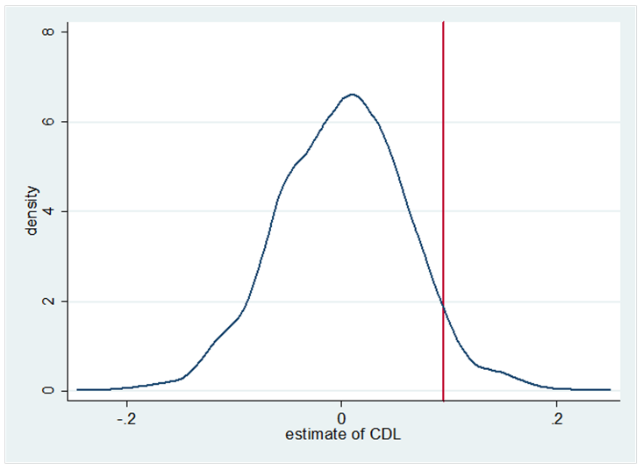
Homicide – Statistical Inference
OLS-Weighted
Estimate = 0.0946
5.0% of placebo estimates lie to the right of the estimate;

Slide 117
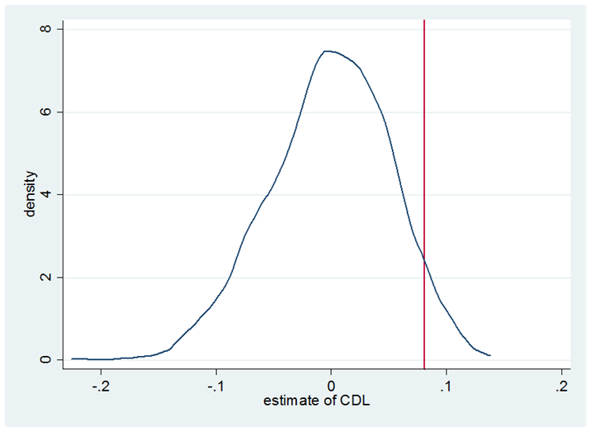
Homicide – Statistical Inference
OLS-Unweighted
Estimate = 0.0811
5.3% of placebo estimates lie to the right of the estimate

Slide 118
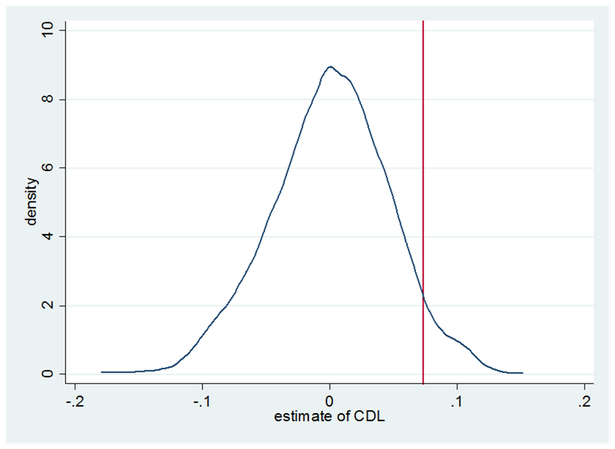
Homicide – Statistical Inference
Negative Binomial
Estimate = 0.0734
4.6% of placebo estimates lie to the right of the estimate

Slide 119
Interpretation
Summary: Castle Doctrine/Stand Your Ground laws lead to ~8% increase in the homicide rate
600 additional homicides per year
Lingering Question: Could these homicides have been misreported as murders or manslaughters, even though they actually were legally justified?
Misreporting is a concern: Kleck (1988) estimates that one-fifth of legally justified homicides are correctly reported
Side note: This net increase in homicides could not be driven by one-for-one substitution of would-be-homicide victims killing their assailants

Slide 120
Interpretation
Approaches:
Look for evidence of increases in homicides that are unambiguously unjustified
(e.g., felony murders, gang-related homicides, share of robberies with a gun, etc.)
Findings: nothing much helpful

Slide 121
Interpretation
Approaches:
Combine estimates of relative increase in justifiable homicides with estimates of misreporting to assess whether all the additional homicides could have been legally justified
Largest estimate of relative increase in justifiable homicide: 70%
Baseline number of justifiable homicides in castle doctrine states: 103
Estimate of percentage of correctly reported legally justified homicides: 20%
Assumptions:
i) Police are not less likely to report an otherwise identical homicide as legally justified after the passage of castle doctrine/stand-your-ground
ii) The relative increase in legally justified homicides is no lower for reporting agencies than for non-reporting agencies
Conclusion: At most 300 of the additional 600 homicides could have been legally justified
=> Some escalation of violence that is unambiguously “bad”

Slide 122
Conclusions
No evidence that Castle Doctrine/Stand-Your Ground Laws deter violent crimes such as burglary, robbery, and aggravated assault
These laws do lead to an 8% net increase in homicide rates, translating to around 600 additional homicides per year across the 21 adopting states
Unlikely that all of the additional homicides were legally justified
Economics of crime and behavior: Incentives and expected costs appear to matter in some contexts, but not in others

Slide 123
Synthetic control
Natural experiment methodologies (cont.)

Slide 124
Comparative Case Studies
Qualitative comparative case studies:
Goal is to reason inductively the causal effects of events or characteristics of a single unit on some outcome, but oftentimes done through logic and historical analysis
May not answer the causal inference well or at all since there is often not a counterfactual or an ad hoc counterfactual
Example: Alexis de Toqueville’s Democracy in America
De Touqueville comes to the US in the 19th century to study our prisons
Writes classic political economy book on US institutions
Quantitative comparative case studies
Usually natural experiment methodologies applied to a single aggregate unit (e.g., city, school, firm, state, country)
Goal is to estimate causal effect of some intervention on some outcome by comparing the evolution of the aggregate outcome in the treatment unit to the evolution of some aggregate control group

Slide 125

Motivating example: Mariel Boatlift
How do inflows of immigrants affect the wages and employment of natives in local labor markets?
Card (1990) uses the Mariel Boatlift of 1980 as a natural experiment as it caused a 7% surge in the Miami labor force due to Cuban immigration
Card uses individual-level data on unemployment and wages from the Current Population Survey (CPS) for Miami and four comparison cities (Atlanta, Los Angeles, Houston and Tampa-St. Petersburg) and estimates diff-in-diff
History of thought: classic study because in addition to the findings, it is one of the first applications of the diff-in-diff research design and is cited in his John Bates Clark award

Slide 126
Motivating example: The Mariel Boatlift
Differences-in-differences estimates of the effect of immigration on unemployment from Card (1990, Tables 4 columns 2 and 3) standard errors in parentheses
Interpreting DD table:
First difference (2-1): difference across
Second difference (3a-3b; 3d-3e): difference down the first difference you computed in part 1
(You can also difference down then across – same answer either way)
Estimated average treatment effect on the treatment group is -1.1 for Whites and -1.0 for Blacks.
Conclusion: Mariel Boatlift-induced immigration reduced unemployment by 1 percentage point
Group | 1979 (1) | 1981 (2) | 1981-1979 (3)
Whites
(a) Miami | 5.1 (1.1) | 3.9 (0.9) | -1.2 (1.4)
(b) Comparison cities | 4.4 (0.3) | 4.3 (0.3) | -0.1 (0.4)
(c) Difference Miami-comparison | 0.7 (1.1) | -0.4 (0.95) | -1.1 (1.5)
Blacks
(d) Miami | 8.3 (1.7) | 9.6 (1.8) | 1.3 (2.5)
(e) Comparison cities | 10.3 (0.8) | 12.6 (0.9) | 2.3 (1.2)
(f) Difference Miami-comparison | -2.0 (1.9) | -3.0 (2.0) | -1.0 (2.8)

Slide 127
Identifying assumptions in DD
Differences-in-differences (DD) identifies the average treatment effect on the treatment group (ATT) parameter:
Definition of ATT: E[Y¹|D=1, T=1] – E[Y⁰|D=1, T=1]
Second term is “counterfactual” – it never occurred and is therefore unobserved
DD research designs require strong (untestable) assumptions about counterfactual time paths treatment group outcomes (Y)
Parallel trends assumption: Rate of change in Y for control group from pre- to post-treatment period equals rate of change in Y for treatment group from pre- to post-treatment period had treatment not been assigned (counterfactual)
E[Y⁰|D=1,T=1]–E[Y⁰|D=1,T=0]=E[Y⁰|D=0,T=1]–E[Y⁰|D=0,T=0]

Slide 128
Identification in DD (Graphical)
Notes:
The algebra of least squares is such that when you estimate the conditional mean of Y as a function of a post-treatment dummy (T), a treatment group dummy (D) and an interaction (DxT), the coefficient on the interaction identifies the space in the top right with the arrow connecting the hollow circle and the black circle. This is the causal effect of the treatment obviously if and only if the dashed upward slop from E[Y0(0)|D=1] in pre-treatment to E[Y0(1)|D=1] in post-treatment is correct. But that is only the case because our control group’s time path is the parallel line beneath it. Hence we see the critical nature of the correctly choosing the proper control units – these units must be chosen because they uniquely exhibit the temporal dynamics over this period that is identical to that of our treatment group’s counterfactual time path.

Slide 129
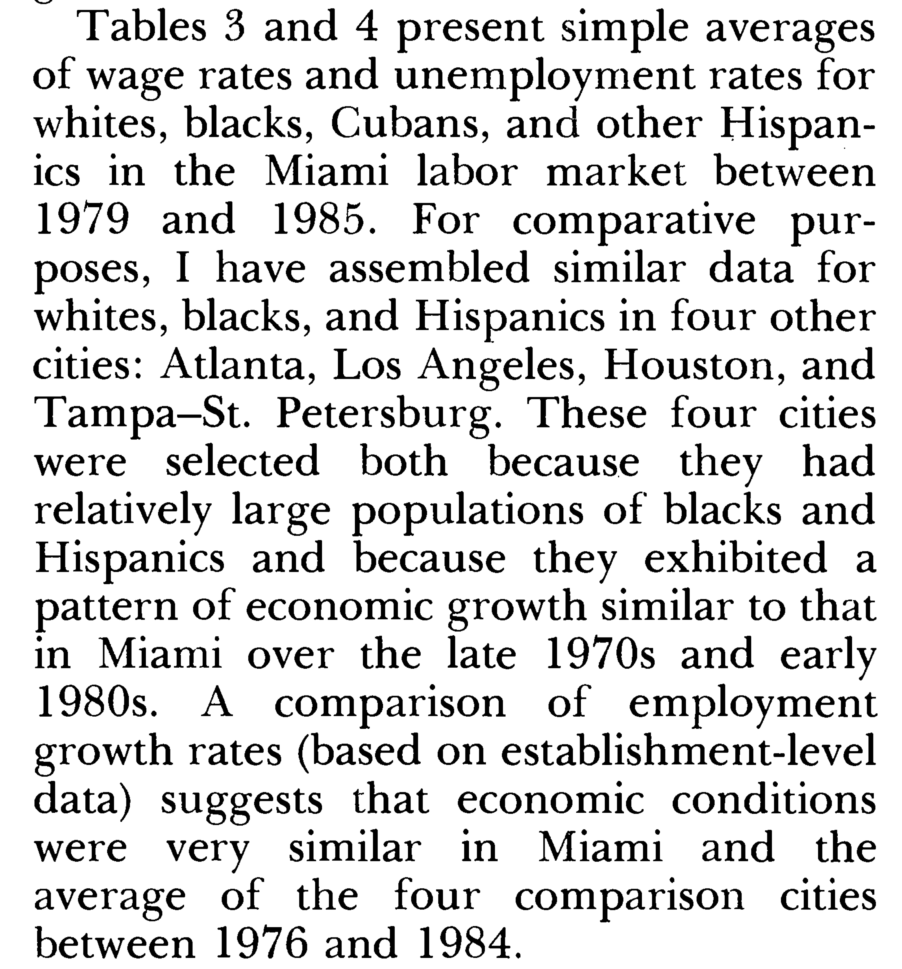
Selection of controls
How did Card (1990) select Los Angeles, Tamp, Houston and Atlanta as comparison cities?
“These four cities were selected because they had relatively large populations of blacks and Hispanics and because they exhibited a pattern of economic growth similar to that in Miami over the late 1970s and early 1980s.”
Implicit assumption in choosing four cities:
Change in average unemployment for Miami from 1979 to 1981 had Mariel Boatlift never occurred (counterfactual trend)
equals
Change in average unemployment for ATL, HOU, Tampa and LA from 1979 to 1981 (observed trend)
Are demographics predictive of the outcome of interest pre-treatment? Does Card’s synthetic Miami reproduce the time-path of Miami in earlier periods?

Slide 130
Advantages and disadvantages
What are the advantages of comparative case studies?
Policy interventions often take place at an aggregate level
Aggregate/macro data are often available
What are the disadvantages?
Selection of the control group is often ambiguous (e.g., Card 1990)
Standard errors do not reflect uncertainty about the ability of the control group to reproduce the counterfactual of interest
Split the difference with synthetic control method
Same advantages, fewer of the disadvantages

Slide 131
The Synthetic Control Method
Key papers for further reading
Abadie and Gardeazabal (2003) “The Economic Costs of Conflict: A Case Study of the Basque Country”, American Economic Review, 93(1), March 113-132
Abadie, Diamond and Hainmueller (2010) “Synthetic Control Methods for Comparative Case Studies: Estimating the Effect of California’s Tobacco Control Program”, Journal of the American Statistical Association, 105(490), June, 493-505.
Abadie, Diamond and Hainmueller (2011) “Synth: An R Package for Synthetic Control Methods in Comparative Case Studies”, Journal of Statistical Software, 42(13), June, 2-17.
Abadie, Diamond and Hainmueller (2012) “Comparative Politics and the Synthetic Control Method”, Unpublished manuscript
Notes:
I would encourage you to read the last three mainly. I personally like reading statistical software documentation because in it, the authors are often “speaking my language” since I am first and foremost an applied microeconomist (as opposed to an econometrician). Because the authors are explaining precisely how particular parameters are calculated, I can often see things in it that I didn’t understand from the original piece. The creation of the V matrix of weights is clearer in reading the 2011 JSS piece than was the case for me in reading the 2010 JASA.

Slide 132
Basic ideas
When to use synthetic control: causal inference questions, aggregate data, one treatment unit
You are interested in the causal effect of some intervention on some outcome of interest
Ex: School choice on academic performance
Units are aggregate (e.g., school, firm, country, state, region) as opposed to samples of the population
Census longform is a 10% sample of the US population (sampling uncertainty)
Administrative records for students at A&M is aggregate (no sampling uncertainty)
Treatment assignment is aggregate and affects one unit
Ex: Massachusett’s healthcare reform only in MA, and affected all of Massachusett

Slide 133
Basic Ideas (cont.)
Key concept: composites can be better mimics than individual comparisons
We can often reproduce the characteristics of a unit(s) using combinations of control units than trying to find the perfect one unit for comparison
Example: What’s the effect of RG3 winning the Heisman on Baylor student academic achievement and enrollment?
Problem: Who is like Baylor??
Solution: “Frankenstein Baylor” – combine 4-5 other schools vs. trying to find the “perfect other school”
Synthetic control method optimally selects weights to create “Frankenstein” versions of the treatment group
Weights are optimal in that they are selected by an algorithm using pre-treatment data and a reservoir of control group units such that the “Frankenstein” looks and acts like the treatment group prior to the intervention
Weights are selected based on pre-treatment data only, but causal inference is based on comparing the fit of the model post-to-pre treatment
Baylor outcomes: pre-RG3 vs. “Frankenstein Baylor” pre-RG3. Hopefully they look very similar
Baylor outcomes: post-RG3 vs. “Frankenstein Baylor” post-RG3. Their difference is the estimated causal effect of RG3 on that event
Assumes no spill-overs from treatment onto controls, including no general equilibrium effects
More appropriate, probably, for short-run shocks
Inference method is demanding, and so causal effects must be large enough

Slide 134
Synthetic Control: Advantages
Advantages
Doesn’t extrapolate beyond support of data
Estimated counterfactual is a convex combination of other units’ outcome, which precludes extrapolation beyond the support of the data
OLS extrapolates beyond the support of the data
Transparency
Synthetic control produces a vector of weights – you know precisely who forms your counterfactual and by how much
OLS is a black box by comparison even though it also creates implicit weights
Builds on other comparative case study practices
Allows for a mixture of qualitative and quantitative methods – e.g., if Arizona contributes 50% to your synthetic Rhode Island unit, you know to scrutinize Arizona to try and better understand why pre-treatment the two units performed so well together
Reduced opportunity for subjective researcher bias
Synthetic control formalizes the selection of comparison units and therefore removes the temptation of researchers to endogenously choose comparison cities based on either ad hoc reasoning and/or researcher biases
Inference
Represents not only a formal way of systematizing comparative case studies, but it also provides a permutation-based method of inference for quantifying uncertainty

Slide 135
Synthetic control: disadvantages
Audience ignorance can be a problem since this is new and competes with DD
While this is changing, quite common to be met with skepticism by practioners who prefer diff-in-diff for no other reason than that they are familiar with it
Means synthetic control is still viewed as a “robustness” check, as opposed to the principal design used in program evaluation
Level of problem: not a big deal, and won’t matter if you do this in addition to everything else (which you should be doing anyway)
Volatility in pre-treatment series can cause you to never find a suitable synthetic control
Level of problem: bigger deal in a sense, but should you be using DD if you learn from synthetic control that there doesn’t exist any composite that can reproduce your treatment group? Wouldn’t you rather know, in other words, than just run regressions?
Lots of model fitting
Although you are model fitting on the pre-treatment series, and thus technically this is done prior to the actual estimation itself, -synth- and other packages does this in one swoop thus defeating in some sense one of the motivating purposes of the procedure which is to reduce researcher bias
Level of problem: in my opinion, probably the biggest “black box” part of synthetic control

Slide 136
Synthetic control method: Formalization
Suppose J+1 units in periods 1, 2, …, T
Unit “one” is the treatment group unit (“treated”) exposed to the intervention of interest during periods T₀+1, …, T
Ex: 49 control states and 1 treatment state; J=49 plus the 1 treatment state is 50 states
T₀ in this notation is the number of pre-treatment time periods (e.g., 10 periods pre-treatment, so T₀=10).
Remaining J units are called the “donor pool” as they are the untreated reservoir of potential controls
Goal is to find a combination of untreated units from the donor pool (J) that resemble the treated unit (j=1) prior to the intervention in terms of k relevant covariates (predictors of the outcome of interest)
User can choose to include as many as M linearly independent combinations of pre-intervention outcomes so long as M is less than or equal to T₀ to control for unobserved common factors
Today’s motivating example: 1988 California California’s tobacco control program
Treatment unit is California
Treatment is Proposition 99
Outcome of interest is tobacco consumption in California after 1988
Donor pool is all states that did not receive similar legislation during this period
Covariates are the predictors of state-level tobacco consumption measured before 1988

Slide 137
Synthetic control method: Formalization
Consider a set of weights w₂, …, w_{J+1}, where the following criteria hold:
Each weight is non-negative (0 or positive)
Weights must sum to 1
Estimation of weights: constrained minimization
Let X_{jm} be the value of the m^{th} covariates for unit j
Choose w*_{2,} … , w*_{J+1} that minimizes the following (subject to above constraints):
V is defined as some (k x k) symmetric and positive semidefinite matrix
V is introduced to allow different weights to the variables in X₀ and X₁ depending on their predictive power on the outcome Y
An optimal choice of V assigns weights that minimize the mean square error of the synthetic control estimator, that is the expectation of (Y₁-Y₀W*)’(Y₁-Y₀W*)

Slide 138
Optimal V matrix
Abadie, et al. (2010) propose a data-driven procedure to choose V, and this is implemented by default in –synth–
V* is chosen among all positive definite and diagonal matrices such that the mean squared prediction error (MSPE) of the outcome variable is minimized over some set of pre-treatment periods
Let Z₁ be a vector with the values of the outcome variable for the treatment unit for some set of pre-intervention periods
Let Z₀ be an analogous matrix for the control units
The user will choose the number of pre-intervention periods over which the MSPE is minimized

Slide 139
Optimal V matrix
Choose V* that minimizes the following expression where V is the set of all positive definite and diagonal matrices and the weights for the synthetic control are given by W* from the earlier slide

Slide 140
Synthetic Control Method: Formalization
Let Y_{jt} be the value of the outcome for unit j at time t
Weights are applied outcomes and causal effects are differences between actual outcome and synthetic control outcome, or “prediction gap”
The causal effect you are estimating with synthetic control is, like DD, the average treatment effect on the treatment group (not the average treatment effect, in other words)

Slide 141
What about selection on unobservables?
Selection on unobservables: just because two units look the same doesn’t mean they are the same in ways that are relevant to the outcome of interest
Unmeasured factors affecting outcome variables, heterogeneity in the effect itself and treatment selection is problematic as always
Include lagged dependent variables as controls in the X matrix, but you will need a lot of pre-treatment data
Abadie, Diamond and Hainmueller (2010) argue that if the number of pre-intervention periods in the data is large, then matching on pre-intervention outcomes, Y, allows us to control for heterogeneous responses to multiple unobserved factors
What’s the intuition here?
Assume outcomes (Y) are a function of observables (X) and unobservables (u)
By matching on Y pre-treatment, we are incorporating X and u
Only units that are alike in both observed X and unobserved u as well as in the effect of those determinants on Y should produce similar trajectories of the outcome variable over extended periods of time

Slide 142
The Application: California’s Proposition 99
In 1988, California first passed comprehensive tobacco control legislation:
Increased cigarette tax by 25 cents/pack
Earmarked tax revenues to health and anti-smoking budgets
Funded anti-smoking media campaigns
Spurred clean-air ordinances throughout the state
Produced more than $100 million per year in anti-tobacco projects
Other states that subsequently passed control programs will be excluded from their analysis by eliminating these states from the “donor pool”
AK, AZ, FL, HA, MA, MD, MI, NJ, NY, OR, WA, DC all dropped

Slide 143
Cigarette Consumption: CA vs US

Slide 144
Cigarette consumption: CA vs. Synthetic CA

Slide 145
Predictor Means: Actual vs. Synthetic CA

Slide 146
Smoking Gap: CA vs. Synthetic CA

Slide 147
Inference
So what?
I still don’t know how confident to be about these post-estimation estimates of causal effects unless I have some way of quantifying the uncertainty
What kind of uncertainty, though, ultimately are worried about?
Counterfactual uncertainty. The fundamental problem of causal inference is that we do not have counterfactuals on individual units, and therefore cannot directly measure causal effects
Cannot observe California and smoking in the counterfactual state
Randomness. Secondly, related to this, for all we know, this model produces a picture just like the previous ones even if it’s applied to states that didn’t pass Proposition 99
In other words, maybe synthetic control models fitted with pre-treatment data always dissolve like that – in which case, that picture isn’t so convincing anymore

Slide 148
Inference
To evaluate the significance of our results using synthetic control, we will conduct a series of “placebo” experiments where we reassign the tobacco control program to states other than California
1. Iteratively apply the synthetic method to each unit in our “donor pool” to obtain a distribution of these “placebo effects”
2. Compare the “prediction gap” (RMSPE) for California to the entire distribution of these estimated “placebo effects”
3. Is the effect that we estimated with synthetic control for California large relative to the “placebo effects” we estimated for a state chosen at random?

Slide 149
Smoking prediction gap for CA and 38 placebos

Slide 154
Further falsification exercises
In Abadie, et al. (2012) the authors propose more applications, but more importantly for us, more robustness exercises
We will consider primarily two of them:
Shifting the treatment data within treatment group
Removing units from the synthetic control

Slide 155
Application 2: The 1990 German Reunification
Cross-country regressions are often criticized because they put side-by-side countries of very different characteristics
“What do Thailand, the Dominican Republic, Zimbabwe, Greece, and Bolivia have in common that merits their being put in the same regression analysis? Answer: For most purposes, nothing at all.” (Harberger, 1987).
The synthetic control method provides us with a data-driven procedure for selecting the appropriate comparison units, thereby addressing Harberger’s complaints
Application: examine the economic impact of the 1990 German reunification in West Germany
Abadie, Diamond and Hainmueller (2012), unpublished manuscript
They limit the donor pool to 16 OECD countries

Slide 156
West Germany vs OECD sample

Slide 159
Country weights (w*) in the synthetic control

Slide 160
Comparison to Regression
Constructing a synthetic comparison as a linear combination of the untreated units with coefficients that sum to one may appear to many as unusual
Abadie, Diamond and Hainmueller (2012) prove, though, that regression-based approaches actually do this very same thing albeit in an implicit way
Unlike synthetic control methods, regression approaches do not restrict the coefficients of the linear combination that define the comparison units to be in between zero and one
As a result, regression-based approaches allow extrapolation beyond the support of the data

Slide 163
Robustness I: Placebo reunification: 1975

Slide 164
Robustness II: Leave-on-out distribution

Slide 165
Sparse Synthetic Controls

Slide 166
Sparse Synthetic Controls

Slide 167
Synthetic Control with 5 Countries

Slide 168
Synthetic Control with 4 countries

Slide 169
Synthetic control with 3 countries

Slide 170
Synthetic control with 2 countries

Slide 171
Synthetic control with 1 country

Slide 172
STATA and R resources
Abadie, Diamond and Hainmueller (2010) is available for STATA and R in a package called “synth”
STATA: . ssc install synth, replace
R: http://www.jstatsoft.org/v42/i13
Permutation-based inference procedure may need to be manually done, though, as their help file documentation has never worked for me (I’m probably just not smart enough)
See my do file from my project on the decriminalization of indoor prostitution and its effect on rapes

Slide 173
Instrumental Variables
Natural experiment methodologies (cont.)

Slide 174
IV Background: Slide 1
Many empirical papers seeking to address the causal effect of one variable (X) on another (Y) will begin by regressing Y on X:
. reg workforpay numkids
For the regression to give a reliable answer to the question of causality, the data must satisfy core assumptions
These assumptions have lots of different flavors as we’ve seen so far. Here is one example of those assumptions: if X is randomly assigned to units, then the regression of Y on X gives a good estimate of what would happen on average if we manipulated a given observation to have a different value of X than it did in reality
In other words, the coefficient on X (numkids) would give us an estimate of the counterfactual because, in reality, the manipulation of X was not what happened
Ex: suppose the 10th observation (“Julie Smith”) had X₁₀=0 and we wondered what would happen if that 10th observation (“Julie”) was manipulated so that she had actually had X₁₀=1. Even though Julie only had X₁₀=0, if X was randomly assigned to units, the coefficient on the regression would give us the effect of a one unit increase in X on Y – on average – across the units in the study
So… what is the regression telling us when X was not randomly assigned?

Slide 175
IV Background: Slide 2
Let the kx1 regression coefficient vector, , be defined by solving the following equation:
Using the first order conditions, we
The coefficient on X in “reg Y X” is an estimate of:

